Slide 1
Transmission Lines for Amateur Radio
Kevin Scott
K4GTR
k4gtr@att.net
February 2025

Slide 2
Types of Transmission Lines
Main types of transmission lines – coax (unbalanced), twin lead/ladder line (balanced), waveguide
Coax – 50 Ohm for communications use, 75 Ohm for Cable TV use
Twin Lead/Ladder Line – 300, 450 & 600 Ohms
See examples of various cable types

Slide 3
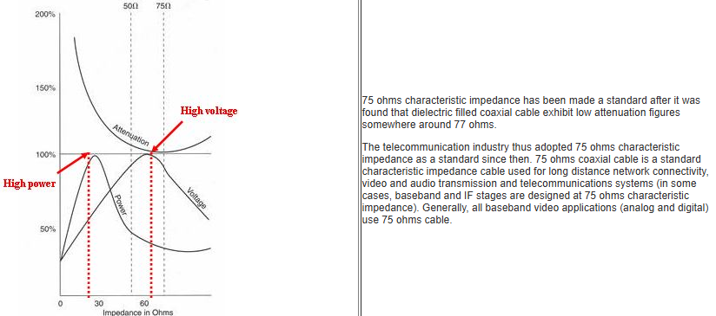
50 vs 75 Ohm Coaxial Cables – WHY?
50 Ohm – Best for Power Transfer (therefore for RF Communications Industry)
75 Ohm – Best for Long Distance (therefore for Cable TV Industry)

Slide 4
50 vs 75 Ohms
The answers to the impedance questions have both historical and technical roots. They begin with the work done by Lloyd Espenscheid and Herman Affel, who developed and analyzed the first coaxial cable in 1929 while working for the legendary Bell Labs. Their goal was to find a transmission medium for propagating a 4 megahertz (MHz) signal (a very wide bandwidth in those early days of long-distance telephony), which was needed to carry about 1000 bandwidth-limited analog voice calls across hundreds of miles. Doing so required a transmission line that could handle both high voltage and high power.
The two researchers analyzed the tradeoffs among key transmission line parameters of attenuation, voltage rating, and power rating (Figure 2).

Slide 5
50 vs 75 Ohms
Their analysis looked at the performance of three characteristics as a function of impedance and they found:
1: Attenuation (loss) is largely a function of the dielectric in the cable. For the air-filled coaxial cable which they analyzed, the lowest loss was at about 77 Ω (it is around 50 Ω for some dielectrics, but such cables did not yet exist).
2: The voltage maximum is a function of the intensity of the electric field between the coaxial outer conductor and the inner conductor. For coaxial cable supporting RF signals in the TE₁₀ electromagnetic (EM) field waveguide mode, the e-field has its maximum at around 60 Ω.
3: The power handling capability is determined by the breakdown field and impedance (V²/Z). For air-filled coaxial cables operating below the TE₁₁ mode cutoff frequency, the power transfer is at its maximum at around 30 Ω.
As with most engineering decisions, there is no “ideal” impedance value; instead, the “best” choice involves balancing tradeoffs. The 50 Ω value is a good compromise for power and voltage, such as that output by a transmitter. In contrast, for situations where low attenuation is the primary goal, such as with low-level signals from an antenna or an analog video link, 75 Ω is a better choice.
Further, there’s another reason why 75 Ω is a desirable impedance. The “natural” impedance of a standard half-wave dipole antenna at its resonant frequency is 73 Ω, while the impedance of the widely used folded dipole antenna is 300 Ω. This means that 75 Ω is a near-perfect match for the larger dipole, while it also is easy to provide a close match to the folded dipole using a basic 4:1 balun.
Using different impedances realizes different objectives in a single design and adds another level of complexity. In practice, the difference in loss over a short run of a few centimeters may be negligible. Further, the voltage standing-wave ratio (VSWR) when connecting a 75 Ω cable to a 50 Ω one is 1.5:1, which may be an acceptable non-unity value (in many low or medium power situations, a VSWR below 2:1 is considered acceptable).

Slide 6
Twin Lead & Ladder Line

Slide 7
Know Your Coax

Slide 8
Know Your Coax – Not all RG8 is the same
The same is true for other coax “types”; RG8X, LMR400…
Some key attributes that affect the RF/electrical performance:
Dielectric type – some have more loss than others
Air, Teflon, Foam, Polyethylene
Shield type and percentage of coverage for flexible types
Low grade coax has a coverage from 60 to 80% braid shield
Better grade coax have 95% braided coverage
The best coax have multiple shields providing 100% coverage
Some use 100% aluminum foil wrapped by tinned-copper braid
Center Conductor
Single conductor vs multi-stranded center conductor
RF performance vs Frequency

Slide 9
Mechanical and Environment Differences
Water is the main enemy of coaxial cable
Jacket types
Some are direct burial, others are not
Some can handle UV light, others degrade quickly, get brittle and crack
Some are submersible in water
Center conductors
Solid (more stiff) vs Stranded (more flexible)
Bend radius
This is the minimum radius required to maintain the advertised impedance. Sharp bends can change the impedance at that point and cause system loss due to reflections

Slide 10
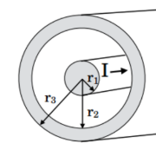
RF Performance vs Frequency
Most RG8 and some RG8X cables are fine for HF frequencies (30 MHz and below) but bad for VHF and HORRIBLE for UHF and higher
For LMR type cables, solid center conductors have less loss than stranded because the inner conductor/outer conductor ratio is more consistent

Slide 11
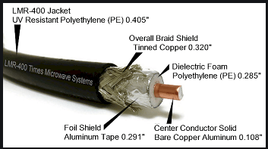
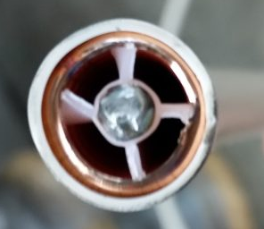
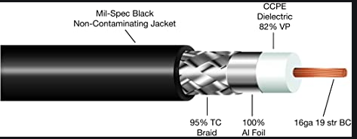
Various Dielectrics and Jacket Coverage
Typical RG8
ABR Industries RG8X
Similar dielectric to 9913

Slide 12
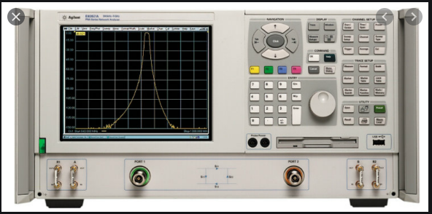
S Parameters
Maybe you have seen references to “S Parameters”? What do they mean?
Refer to the Vector Network Analyzer shown
Port 1
Port 2
Each port can be configured to either be an RF source (TX) or a Receiver (RX)
S Parameters – the numbers refer to the port of the VNA and the path of the Source-to-Receiver
S11 (VSWR or Return Loss to/from Port 1)
S12 (Path Loss from Port 1 to Port 2)
S21 (Path Loss from Port 2 to Port 1)
S22 (VSWR or Return Loss to/from Port 2)

Slide 13
Cataloging Your Coax Jumpers
Test the following:
Continuity from center conductor to center conductor on each end
Short circuit from center conductor to the shield
Static (not moving)
Dynamic (while moving the coax behind the connector)
VSWR (Return loss or S11/S22)
Must have a good 50 non-reactive dummy load on the opposite end of the coax
Static
Dynamic
Cable Loss (from end to end)

Slide 14
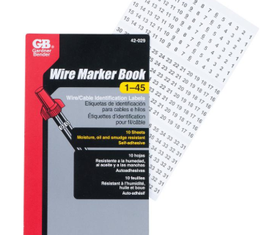
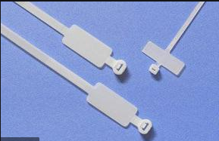
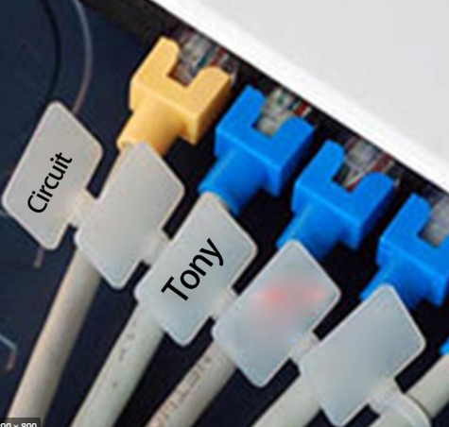
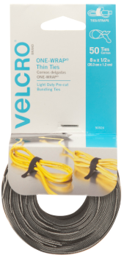
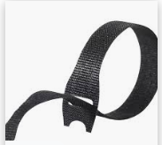
Labeling and Harnessing Methods
Need to use method that does not wash off or peel off
Zip ties with marker space
Wire marker labels; self adhesive
Velcro Thin Ties
There are many other methods

Slide 15
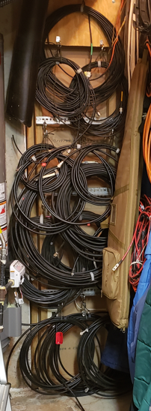
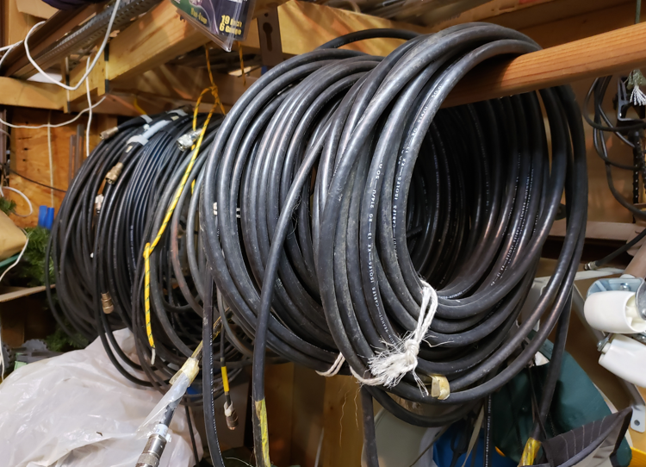
Cataloged Cables

Slide 16
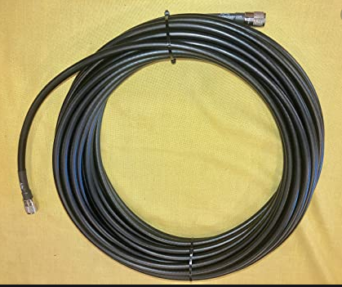
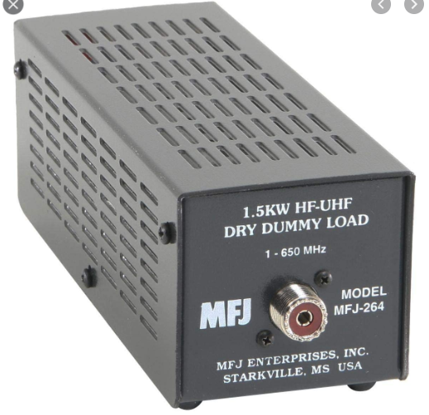
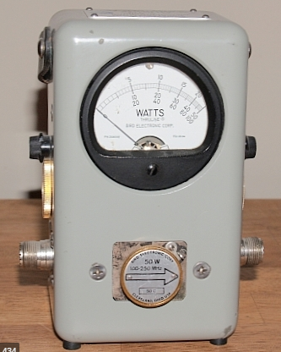
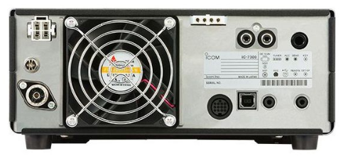
Measuring Cable Loss
Input Power to Coax
Step 1
Step 2
Output Power to Load

Slide 17
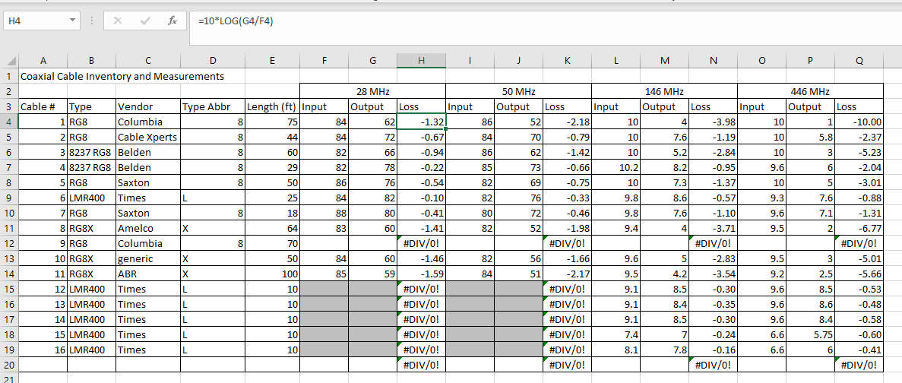
Jumper Cable Inventory – Raw Data

Slide 18
Scaled to 100 Feet to Compare Advertised Specs

Slide 19
LMR – Dash
RG8X – Dot
RG8 - Solid

Slide 20
Comparing LMR Type Cables
Coax Comparison | Attenuation per 100 feet (-dB)
Cost per foot | $ 1.09 | $ 1.09 | $ 1.49 | $ 0.99 |  | $ 0.99 | $ 0.99 | $ 0.79 | $ 1.29 | $ 0.99 | $ 2.00
 | Stranded Center Conductor |  |  |  |  | Solid Center Conductor
Freq (MHz) | ABR400-UF | 9913F7 | LMR-400UF | TWS-400UF |  | 9913 | LMR-400 | TWS-400 | CNT-400 | RF400 | CNT-600 | ABR600
50 | 1.1 | 1.1 | 1 | 1.1 | 50 | 0.9 | 0.9 | 0.9 | 0.97 | 0.9 | 0.6 | 0.5
100 |  | 1.5 | 1.41 | 1.5 | 100 | 1.3 | 1.2 | 1.2 |  | 1.2
150 | 1.8 |  |  |  | 150 |  |  |  | 1.5 |  | 0.97 | 1
220 | 2.2 |  |  |  | 220 |  |  |  | 1.9 |  | 1.17 | 1.2
400 |  | 2.8 | 2.9 | 3.1 | 400 | 2.7 | 2.5 | 2.5 |  | 2.5
450 | 3.3 |  |  |  | 450 |  |  |  | 2.7 |  | 1.71 | 1.7
900 | 4.7 | 4.4 | 4.7 | 4.7 | 900 | 4.2 | 3.9 | 3.9 | 3.9 | 3.8 | 2.5 | 2.5
1000 |  | 4.8 | 4.72 | 5 | 1000 | 4.5 | 4.1 | 4.1 |  | 4.1
1500 | 6.2 |  |  |  | 1500 |  |  |  | 5.1 |  | 3.3 | 3.3

Slide 21
LMR400 Stranded vs Solid Center Conductor

Slide 22
Type N vs UHF PL-259 - Mechanical
Type N Pros
Watertight connector
50 Ohm for minimal loss
Type N Cons
Center conductor pin slides in Teflon insulator – not captured
Cable is held by shield wires via clamp – medium pull strength
Avoid crimp connector types when good mechanical strength is needed
Higher connector cost
PL-259 Pros
Center pin is molded into the connector insulator
Center conductor is soldered into center pin for good mechanical strength
Outer conductor threads into the coax jacket for very good linear strength
Low cost connector
PL-259 Cons
Requires additional waterproofing
Not a 50 Ohm connector
Avoid crimp connector types when good mechanical strength is needed

Slide 23
This is what happens when 75 feet of LMR400 is suspended from a Type N Male connector

Slide 24
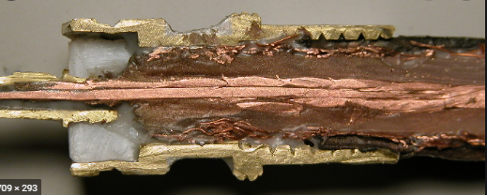
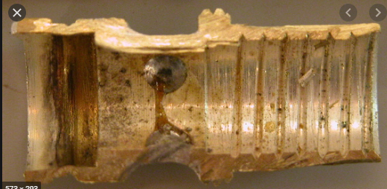
Cross section of Type N and PL 259 connectors
Note the areas highlighted in red.
For Type N – this is mainly for centering the pin at the correct depth
For PL-259 – note that there are several barbs and threads that grab the coaxial cable conductor and jacket

Slide 25
Amphenol Type N Male Connector
Exploded View
The male center conductor pin has a smooth surface that does not “grab” the interior of the center insulator. Therefore it is easy to pull out

Slide 26
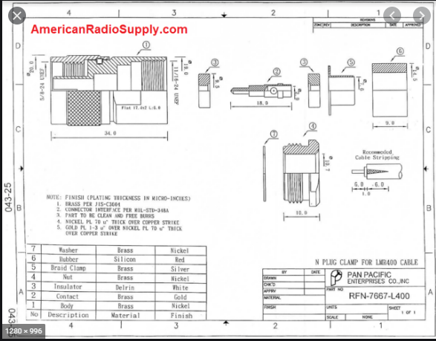
Type N with Clamp
Center pin can pull out of insulator
Clamp Nut compresses the braid against the inside of the connector body but what is to prevent the braid from slipping out?
With this design, there is an extra insulator which should provide additional pull strength but this is not included in most Type N connector models

Slide 27
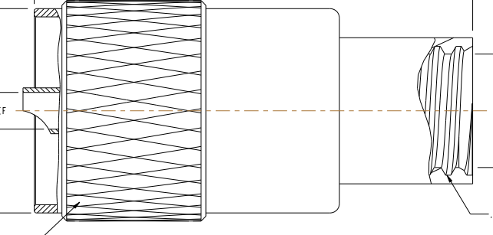
PL-259 Connector Cross-Section
Inside of outer conductor is threaded and grips into the coaxial cable jacket for additional pull strength as well as limited weather sealing
Note the barbs of the center conductor as they grab the center insulator

Slide 28
References
https://www.rfcables.org/articles/18.html
https://www.digikey.com/en/blog/the-reasons-for-50-ohm-and-75-ohm-transmission-lines#:~:text=As%20with%20most%20engineering%20decisions,:1%20is%20considered%20acceptable).
Gain/Loss calculator
http://www.sengpielaudio.com/calculator-amplification.htm
Cable Specs
http://rfelektronik.se/manuals/Datasheets/Coaxial_Cable_Attenuation_Chart.pdf
KE5EE monster antenna farm
https://www.qrz.com/db/KE5EE?fbclid=IwAR3rvbwi05g6NB00hTk5npldvGUbb80Vec6hvNpK5tpRrX6kjS2Rm-mjpMU

